Slide 1
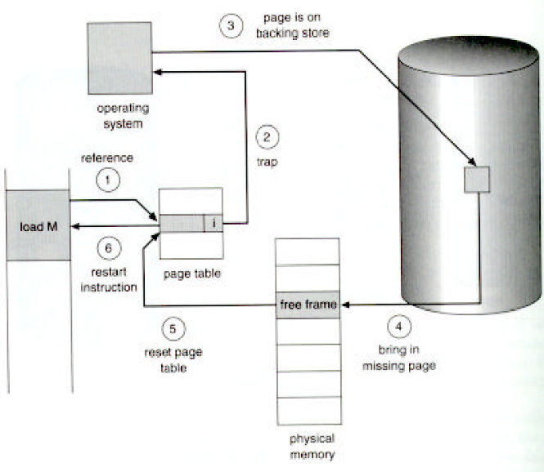
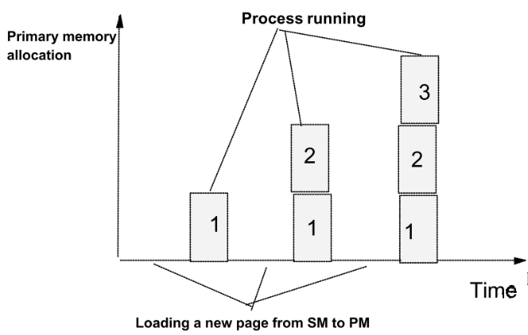
Lecture 7
Virtual Memory Management
Borko Furht
Florida Atlantic University

Slide 2
Demand Fetch Strategy
Page (or segment) is brought from the SM to PM only when it is required.
Demand paging shows reasonable performance because programs tend to have locality of reference.
Page fault: when the page is not in PM.

Slide 3
Handling a Page Fault

Slide 4
Performance of Demand Paging
Memory access time Tm= 10-200 nanosec
Probability of a page fault p (0<=p<=1)
We expect that p is close to 0.
Effective access time Te
Page switch time - Tps Tps = Tl + Ts + Tt
Tl - disk latency time (8 millisec)
Ts - disk seek time (15 millisec)
Tt - transfer time (1 millisec)
Average Tps=25 millisec

Slide 5
Effective Access Time
Te = (1-p)xTm + pxTps
For Tm=100 nanosec and Tps= 25,000,000 nanosec
Te=(1-p)x100 + px25,000,000= 100 + 24,999,900p
For p=0.1%=0.001
Te=100+24,999 nanosec = 25 microsec!!!

Slide 6
Less Than 10% Degradation
110 > 100+25,000,000xp
10 > 25,000,000p
p < 0,0000004
Page fault: less than 1 memory access out of 2,500,000

Slide 7
Page Replacement
If no frame in PM is free, the page replacement algorithm finds one that is not currently being used and free it.
If a page which is modified is selected for replacement, than there are two page transfers: one out and one in.
Use of a modify (dirty) bit in PMT will show what page was modified. For non-modified pages only one transfer: page in.

Slide 8
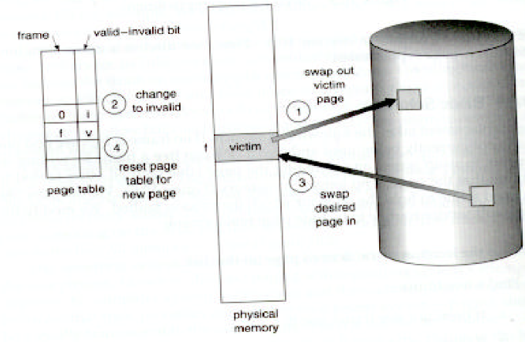
Page Replacement

Slide 9
Page Replacement Algorithms
Optimal algorithm (principle of optimality)
Random page replacement
First-in-first-out (FIFO) algorithm
Least recently used (LRU) algorithm
Reference-bits algorithm
Second-chance algorithm
Enhanced second-chance algorithm
Counting algorithms

Slide 10
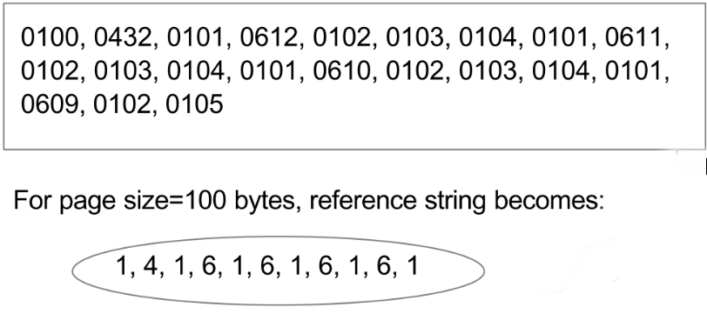
Evaluation of Page Replacement Algorithms
Lowest page-fault rate
Generate reference string
Address sequence

Slide 11
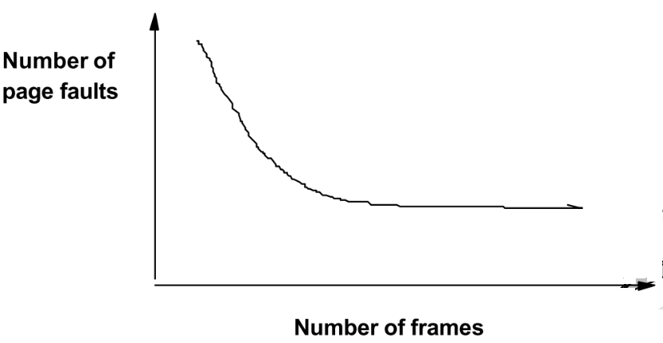
Page Faults Versus Number of Frames
Typically: as the number of frames available increases, the number of page faults will decrease

Slide 12
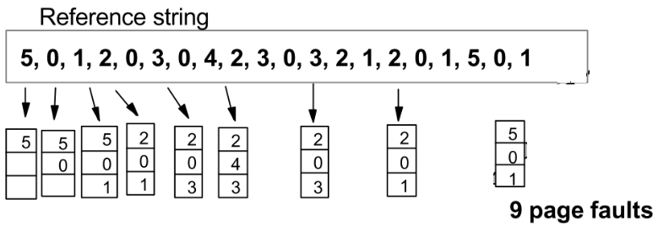
Optimal Algorithm
Replace the page that will not be used again in the near future or for the longest period of time.
It has the lowest page-fault rate.
Unfortunately: hard to predict the future!
Optimal algorithm is used mainly for comparison studies.

Slide 13
FIFO Algorithm
Simplest algorithm
The oldest page is chosen for replacement.
The FIFO queue is used for the implementation of the algorithm and, and the page at the head of the queue is replaced.
Performance is not always good - it is likely to replace heavily used pages.
Example: editor used by many users.

Slide 14
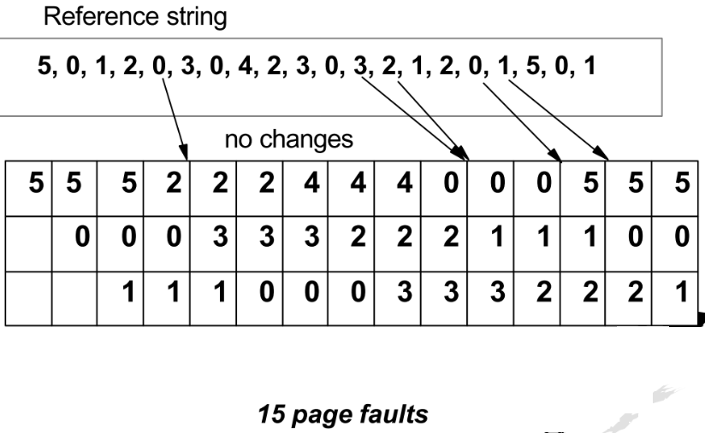
FIFO Algorithm - Example

Slide 15
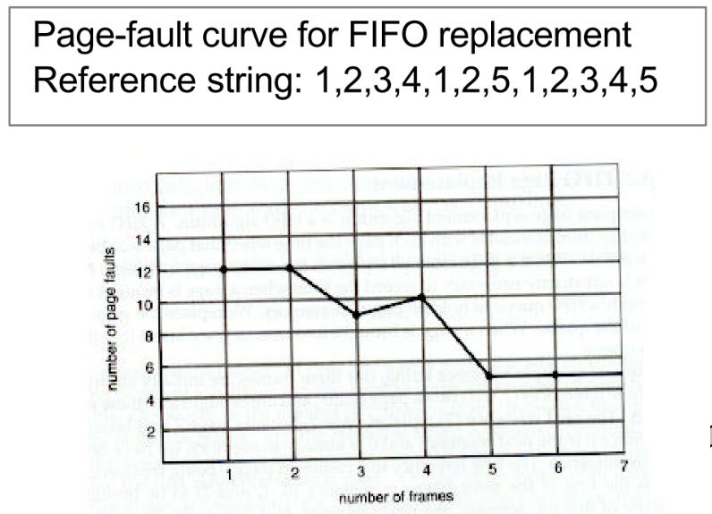
Belady’s Anomaly of the FIFO Algorithm
The number of page faults for more allocated frames is greater than the number of pages for less allocated frames!

Slide 16
Least Recently Used (LRU) Algorithm
LRU algorithm associates with each page the time that page was last used (each page is time-stamped).
LRU chooses the page that has not been used for the longest period of time.
Optimal strategy looking backwards.
LRU is often used in OS.
The major problem is the implementation - may require substantial hardware.
Implementation algorithms: (1) counters, (2) stack

Slide 17
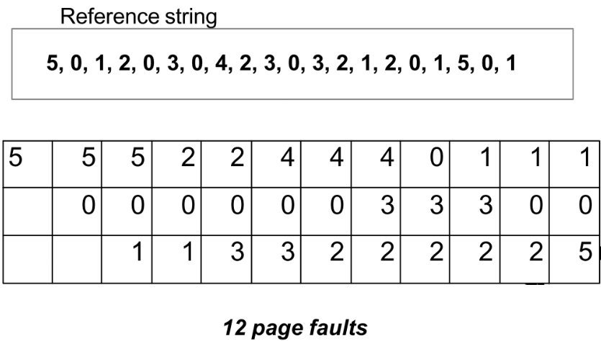
LRU Algorithm - Example

Slide 18
Implementation of LRU Algorithm using Counters
In the PMT: "Time of use" field and CPU has a logical clock or counter
The clock is incremented for every memory reference
When a reference to a page is made, the content of the clock register is copied to the Time of Use field in PMT.
The algorithm replaces the page with the smallest time value.
Requires search of PMT to find the LRU page and a write to a memory (PMT) for each memory access.

Slide 19
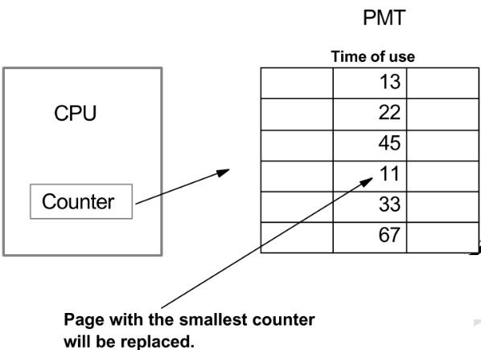
Counter Implementation

Slide 20
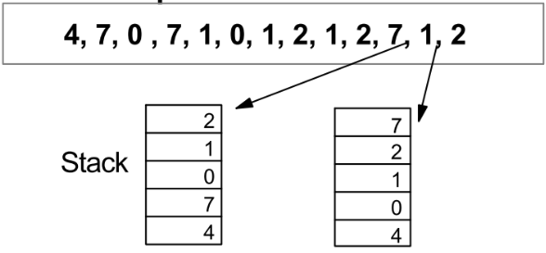
Implementation of LRU Algorithm Using Stack
Keep a stack of page numbers
Whenever a page is referenced, it is removed from the stack and put on the top.
The top of the page is always the most recently used page, and the bottom is the LRU page
Implementation using a doubly linked list, with a head and tail pointer.

Slide 21
Using Reference Bits
If there is no hardware support for LRU, a FIFO algorithm must be used
Some systems provide some assistance, such as a reference bit (r) in PMT.
Initially, all r bits are set by OS to 0.
When a page is referenced, the OS sets the corresponding reference bit to 1.
The reference bits can tell us which pages were used.

Slide 22
Reference-Bits Algorithm
We keep 8-bit for each page in the PMT for reference bits updating.
At regular intervals (e.g. 100 millisec), a timer interrupt transfer control to OS.
The OS shifts the reference bit for each page into the higher-order bit of its 8-bit byte.
This byte contains the history of the page use for the last eight time periods (800 millisec).
For example, if the byte is 00000000, the page has not been used for eight time periods; if it is 11111111, the page is used at least once each period.

Slide 23
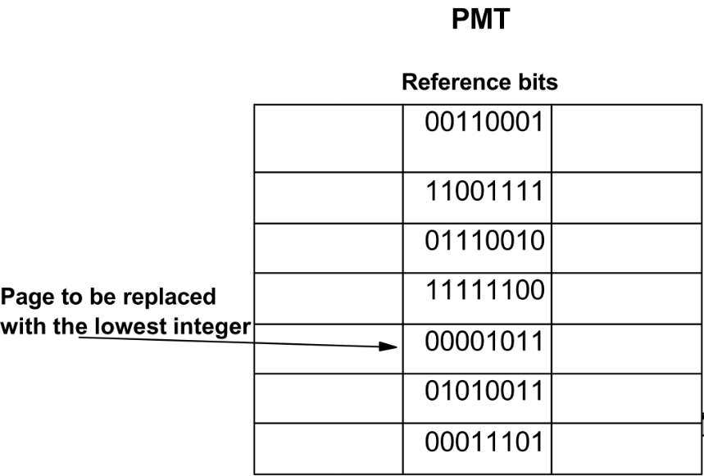
Reference-Bits Algorithm - Example

Slide 24
Second-Chance Algorithm
The basic algorithm is FIFO plus it uses reference bit.
When a page is selected, the algorithm checks the reference bit, if it is 0, it replaces the page.
If r=1, the page gets the second chance, its r bit is cleared and its arrival time is reset to the current time.
If the page is used often enough to keep r=1, it will never be replaced.

Slide 25
Implementation of the Second Chance Algorithm
Using a circular queue and a pointer indicating the next page to be replaced.
When a frame is needed, the pointer advances until it finds a page with r=0.
As it advances, it clears all r bits.
Once a victim page is found, the page is replaced, and the new page is inserted in the queue.
The worst case scenario: all r=1. Then, the pointer cycles through the whole queue, giving each page the second chance.

Slide 26
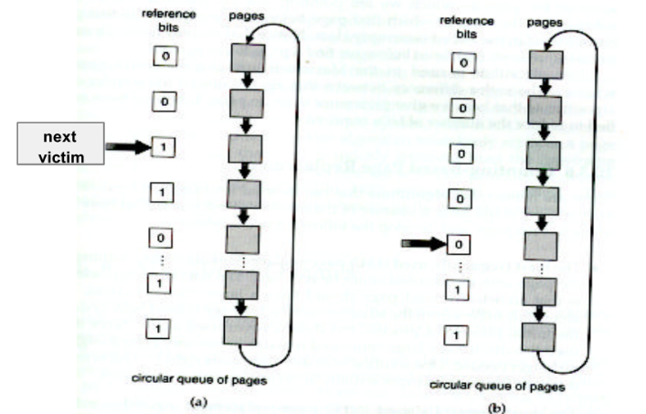
Circular Queue for the Second Chance Algorithm

Slide 27
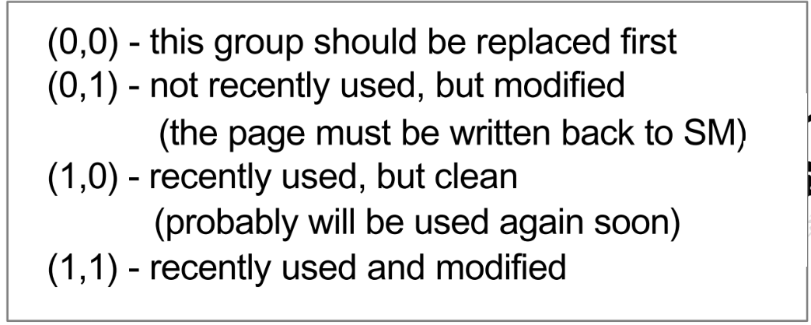
Enhanced Second-Chance Algorithm
Uses two bits: reference bit (r) and modified (dirty) bit (m).
Used in Macintosh VM system
Four possible cases for (r,m)
We may have to scan the circular queue several times

Slide 28
Counting Algorithms
Using a counter of the number of references made to each page.
Least-frequently-used (LFU) algorithm
Most-frequently-used (MFU) algorithm

Slide 29
Least-Frequently-Used Page Replacement Algorithm
The counters are used to count the number of references to each page.
The page with the smallest count will be replaced.
The reason for this: an actively used page should have a large reference count.
Problem: a page is used heavily in the beginning, it has a large count, but it is never used later.
Solution: shift the counts right by 1 at regular intervals.

Slide 30
Most-Frequently-Used Page Replacement Algorithm
The page with the largest count is replaced first.
Reason: the page with the smallest count is just brought to the memory and has yet to be used.
Both MFU and LFU replacement algorithms require expensive implementations, and are not common.

Slide 31
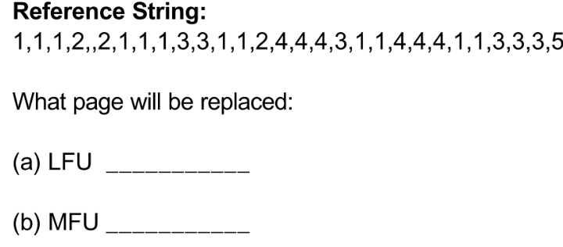
Class Examples
For the following reference string, four page frames are allocated in the primary memory.

Slide 32
Allocation Algorithms
m frames among n processes
(1) Equal share algorithm - every process gets m/n frames.
Example m=100 available frames for n=5 processes. Each process gets m/n=20 frames.
(2) Proportional allocation algorithm - allocation is done according to the size of the process.

Slide 33
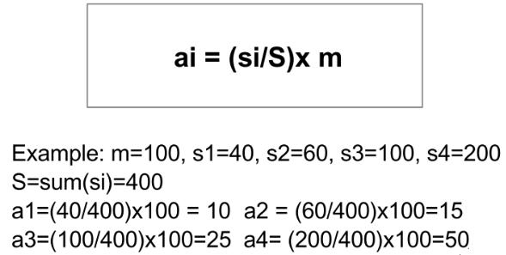
Proportional Allocation Algorithm
The size of process pi is si.
S = sum(si)
We allocate ai frames to each pi according to:

Slide 34
Global Versus Local Allocation
Global replacement: allows a process to select a replacement frame from the set of all free frames, even if that frame is currently allocated to another process.
Local replacement: each process selects the frame from its own set of allocated frames.
An allocation scheme: high-priority processes can select frames from low-priority processes.
Global replacement results in greater system throughput - more common method.
Problem with global replacement: a process cannot control its own page-fault rate.

Slide 35
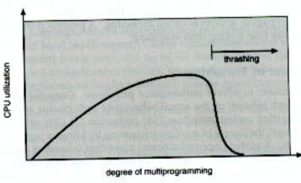
Thrashing
Trashing is the high paging activity
If the number of frames for a low-priority process falls below the minimum number required by the computer architecture (2 to 6 frames) - the process faults very quickly
Effects of thrashing can be limited by using a local replacement algorithm

Slide 36
Principle of Locality
One of the most useful principles in memory management strategies.
Temporal locality - locality over time. Memory locations referenced recently are likely to be referenced in the near future.
Examples: looping, subroutines and procedures, stacks, variables for counting.
Spatial locality: memory references tend to be clustered so that once a location is referenced, it is likely that nearby locations will be referenced.
Examples: arrays, sequential code execution.

Slide 37
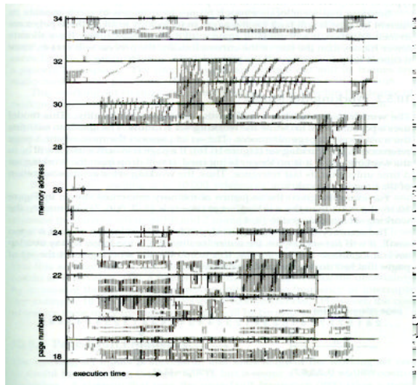
Locality in a Memory Reference Pattern

Slide 38
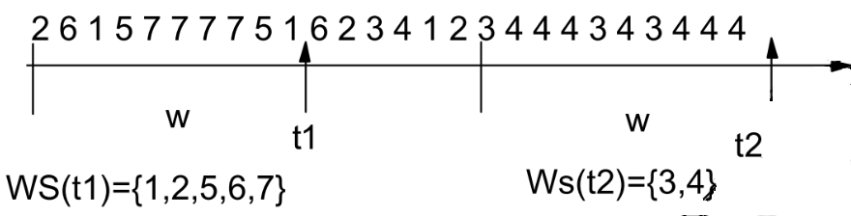
Working Set Memory Management Policy
Idea: to maintain the working set (WS) of active pages in PM.
The WS of pages for a process, W(t,w) at time t is the set of pages referenced by the process during the time interval t-w to t (working-set window).

Slide 39
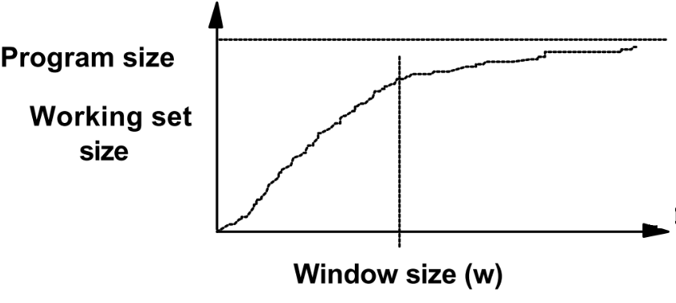
Working-Set Model Issues
Selection of the window size (w).
w too small - it does not encompass the entire locality
w too large - it may overlap several localities.
The working set window is a moving window difficulty is keeping track of the working set.
The next WS may differ substantially from the previous WS.

Slide 40
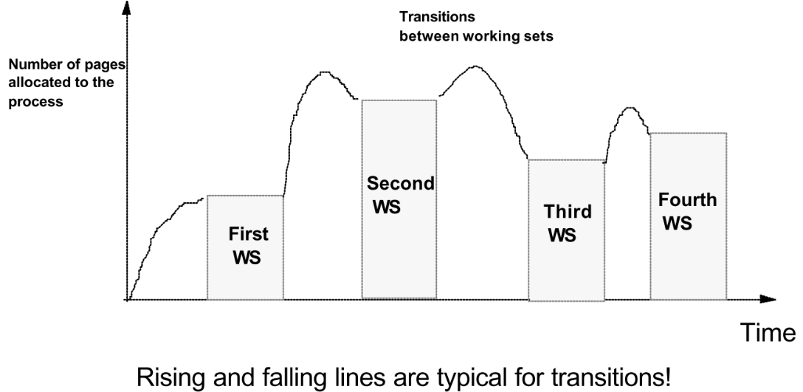
Page Allocation Under Working Set Memory Management

Slide 41
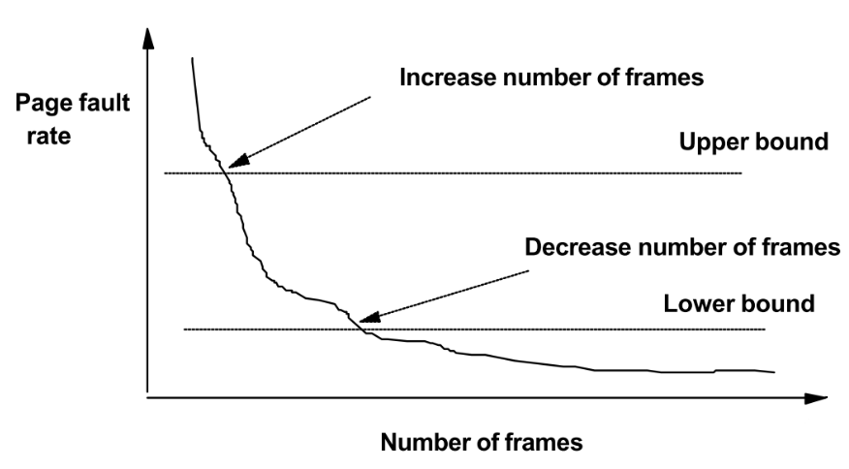
Page-Fault Frequency Memory Management Strategy
The WS model can be useful for prepaging, but it is not good to control thrashing.

Slide 42
Problems with Demand Paging

Slide 43
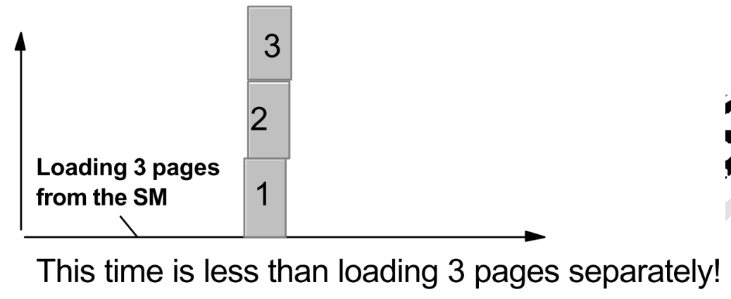
Anticipatory Paging and Prepaging
Large number of page faults occurs when a process is started.
Prepaging strategy - bring into memory at one time all the pages that will be needed.
The OS attempts to predict the pages which will be used in a near future and preloads these pages, when space is available.

Slide 44
Selection of Page Size
How do we select the page size?
(1) Size of the page table --> smaller page size increases the number of pages and the size of the PMT.
Example; virtual memory=4 MB will have 4096 pages of 1 KB, or 512 pages of 8 KB!
(2) Memory utilization - better with smaller pages. This is internal fragmentation - half of the page size will be wasted.
(3) I/O transfer to read and write the page from SM. It is better to have larger pages -- reduces the number of transfers.

